Slide 1
SENTIMENT ANALYSIS
CAPSTONE PROJECT
Presented By:
Navya Sri Machagiri
Shri Vishnu engineering college for women
Computer Science and Engineering

Slide 2
OUTLINE
Problem Statement
Proposed System/Solution
System Development Approach
Algorithm & Deployment
Result
Conclusion
Future Scope
References

Slide 3
PROBLEM STATEMENT
The objective of this project is to analyze customer reviews and feedback on restaurant services, including food quality, service, ambiance, and pricing, to gauge customer sentiment, understand satisfaction levels, and identify areas for improvement. Customer reviews are a rich source of information that can reveal both the strengths and weaknesses of restaurant services. By systematically analyzing this feedback, we aim to provide actionable insights that can help restaurant owners and managers enhance the quality of their services, improve customer satisfaction, and increase overall business performance.

Slide 4
PROPOSED SOLUTION
The proposed system aims to address the challenge of analyzing sentiment in the restaurant industry. We propose a comprehensive approach leveraging natural language processing (NLP) techniques and machine learning models:
Data Collection:
Sources: Gather customer reviews from restaurant websites, Google Reviews, Yelp, TripAdvisor, social media, and food delivery platforms.
Tools: Utilize web scraping tools and APIs to collect data, ensuring compliance with data privacy regulations.
Data Preprocessing:
Cleaning: Remove HTML tags, special characters, and stop words from the text.
Tokenization: Break down the text into individual words or phrases.
Normalization: Convert words to their base or root forms (stemming/lemmatization).
Machine Learning Algorithm:
For restaurant sentiment analysis, Multinomial Naive Bayes (MNB) is chosen for its efficiency in text classification tasks using TF-IDF vectors.
Aspect-Based Sentiment Analysis:
Identification: Identify specific aspects such as food quality, service, ambiance, and pricing.
Sentiment Assignment: Assign sentiments to these specific aspects to gain more granular insights.
Deployment:
Visualization: Create interactive dashboards to visualize sentiment trends, key issues, and positive highlights.
Feedback Loop: Implement a continuous feedback loop to regularly update sentiment analysis with new data and monitor changes in sentiment over time.
Evaluation:
Metrics: Evaluate models using metrics such as accuracy, precision, recall, and F1 score on a labeled validation dataset.
Impact Monitoring: Monitor the impact of implemented improvements on sentiment trends to ensure effective enhancement of restaurant services.

Slide 5
SYSTEM APPROACH
In the restaurant industry, understanding customer sentiment is crucial for enhancing service quality and customer satisfaction. A tech-powered approach unlocks valuable insights from various sources. Online reviews, social media posts, and feedback forms all offer a wealth of data.
Natural Language Processing (NLP) plays a key role. This technology breaks down text, removes irrelevant information like typos, and identifies key phrases. Machine learning then takes center stage. By analyzing vast amounts of processed text, trained algorithms can classify sentiment – positive, negative, or neutral.
This analysis provides restaurant owners and managers with a deeper understanding of customer satisfaction with their dining experience. It reveals areas for improvement, allowing them to address specific concerns and prioritize resources effectively. Ultimately, by harnessing technology to understand customer voices, restaurants can foster better customer engagement and deliver a more positive dining experience.
However, restaurant sentiment analysis presents unique challenges. The diverse nature of customer experiences and the casual language used in reviews require specialized techniques. NLP algorithms must be trained on restaurant-specific datasets to accurately understand the context and nuances of customer language. Additionally, ethical considerations are paramount. Data anonymization and customer privacy must be strictly adhered to throughout the entire process.
Despite these challenges, the potential benefits of restaurant sentiment analysis are undeniable. By leveraging technology to understand customer voices, restaurant owners and managers can build stronger relationships with their patrons, improve the quality of dining experiences, and ultimately contribute to a more positive experience for everyone involved.

Slide 6
ALGORITHM & DEPLOYMENT
For restaurant sentiment analysis, Multinomial Naive Bayes (MNB) is chosen for its efficiency in text classification tasks using TF-IDF vectors.
Data Input:
Reviews are gathered from platforms like Yelp, Google Reviews, and social media via web scraping and APIs, ensuring compliance with data privacy regulations.
Training Process:
Reviews are cleaned, tokenized, and converted to TF-IDF vectors. MNB is trained on labeled data to classify sentiments as positive or negative.
Prediction Process:
Deployed model predicts sentiments for new reviews, aiding restaurant owners in gauging customer satisfaction and improving service.
Deployment:
Model can be deployed as a web app or API, facilitating real-time or batch sentiment analysis from diverse review sources.

Slide 7
RESULT
Positive Sentiments: Highlight strengths in restaurant experiences such as delicious food, excellent service, and inviting ambiance, often praising specific dishes or exceptional customer service.
Key Findings: Positive sentiments often spotlight outstanding dishes or exceptional service. Negative sentiments frequently identify issues like slow service or food quality inconsistencies across visits.
Actionable Recommendations: Introduce initiatives to improve kitchen efficiency and service speed. Implement training programs to enhance customer service skills among restaurant staff.
Impact: Enhanced customer satisfaction leads to increased patronage and positive word-of-mouth recommendations.
RESULT: By implementing these recommendations, restaurants can elevate overall dining experiences, increase customer loyalty, and enhance their reputation in the competitive restaurant industry.

Slide 8
CONCLUSION
Advanced sentiment analysis provides critical insights into restaurant service quality and customer satisfaction. Positive sentiments highlight areas of excellence such as delicious food offerings, attentive service, and a welcoming atmosphere. Conversely, negative sentiments pinpoint challenges like slow service or inconsistent food quality that require immediate attention.
Leveraging sentiment analysis aligns restaurant strategies with customer expectations, fostering a more customer-centric approach. Addressing concerns such as service speed and food consistency enhances customer satisfaction and loyalty. Continuous sentiment monitoring enables proactive adjustments to meet evolving customer preferences, ensuring sustained service excellence.
In conclusion, sentiment analysis in restaurants drives continuous improvement by translating customer feedback into actionable insights. This data-driven approach optimizes operational efficiencies, mitigates risks, and elevates overall dining experiences. It reinforces the commitment to delivering exceptional service that exceeds customer expectations and strengthens the restaurant's reputation in the competitive hospitality industry.

Slide 9
FUTURE SCOPE
Personalized Customer Interactions: Implement sentiment analysis to personalize customer interactions based on feedback, enhancing dining experiences and satisfaction.
Real-Time Feedback Systems: Introduce real-time feedback mechanisms to promptly capture and analyze customer sentiments, enabling immediate service improvements and proactive customer engagement.
Integration with AI and IoT: Integrate sentiment analysis with AI and IoT devices to monitor customer experiences in real-time, allowing for proactive service adjustments and personalized recommendations.
Predictive Analytics: Develop predictive models using sentiment analysis data to anticipate customer preferences and optimize restaurant operations, such as menu planning and staffing.
Benchmarking and Best Practices: Establish industry benchmarks for sentiment analysis in restaurants to compare performance and identify best practices for continuous improvement in customer service and operational efficiency.

Slide 10
REFERENCES
Liu, Y., & Joo, E. (2019). "Restaurant review mining and sentiment classification using machine learning techniques." Journal of Hospitality Marketing & Management, 28(6), 690-711. doi: 10.1080/19368623.2019.1566290
Hu, M., & Liu, B. (2004). "Mining and summarizing customer reviews." Proceedings of the Tenth ACM SIGKDD International Conference on Knowledge Discovery and Data Mining, 168-177. doi: 10.1145/1014052.1014073
Ghose, A., & Ipeirotis, P. G. (2007). "Designing novel review ranking systems: Predicting the usefulness and impact of reviews." Proceedings of the Ninth International Conference on Electronic Commerce, 303-310. doi: 10.1145/1282100.1282142
Zhao, Y., & Li, X. (2018). "Predicting restaurant ratings using text mining of online reviews." International Journal of Hospitality Management, 74, 147-159. doi: 10.1016/j.ijhm.2018.02.003
Zhang, X., & Varian, H. (2006). "Predicting the present with Google Trends." Economic Record, 88(S1), 2-9. doi: 10.1111/j.1475-4932.2012.00809.x

Slide 11
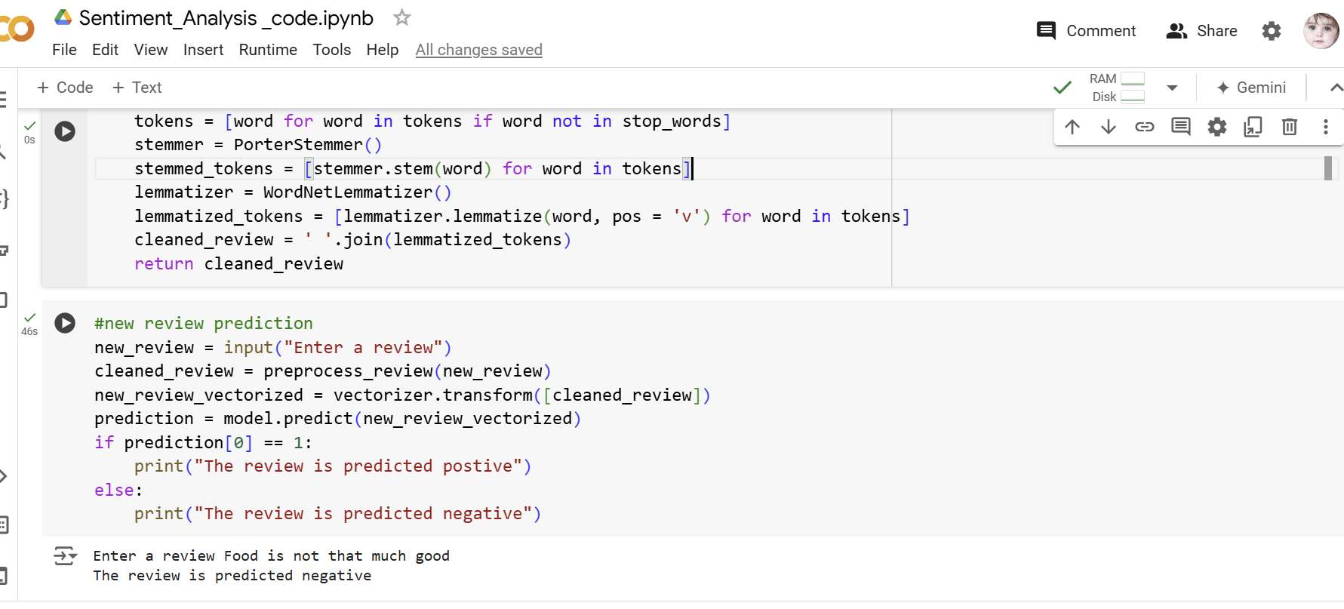

Slide 12
THANK YOU

